Slide 1
VR Exploration Website
CMPE 280 SP18 Team Project
BAM: Bruce Decker, Akash Gupta, Matthew Kwong

Slide 2
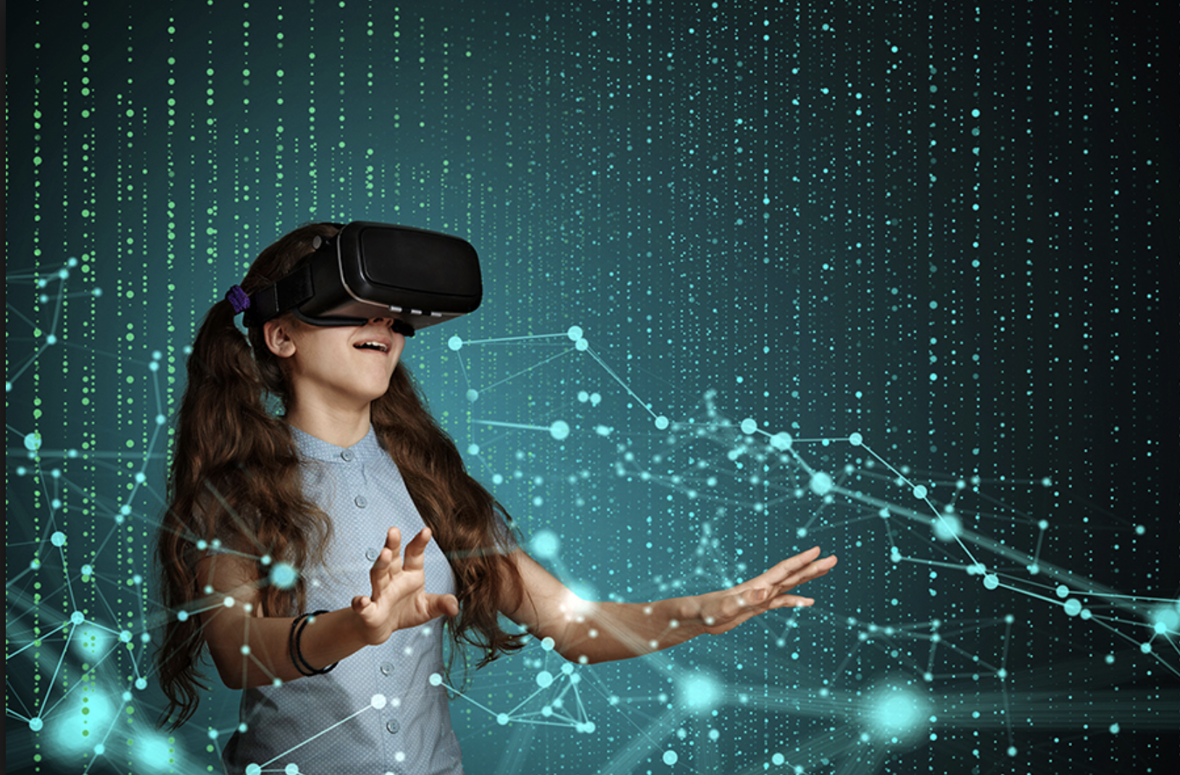
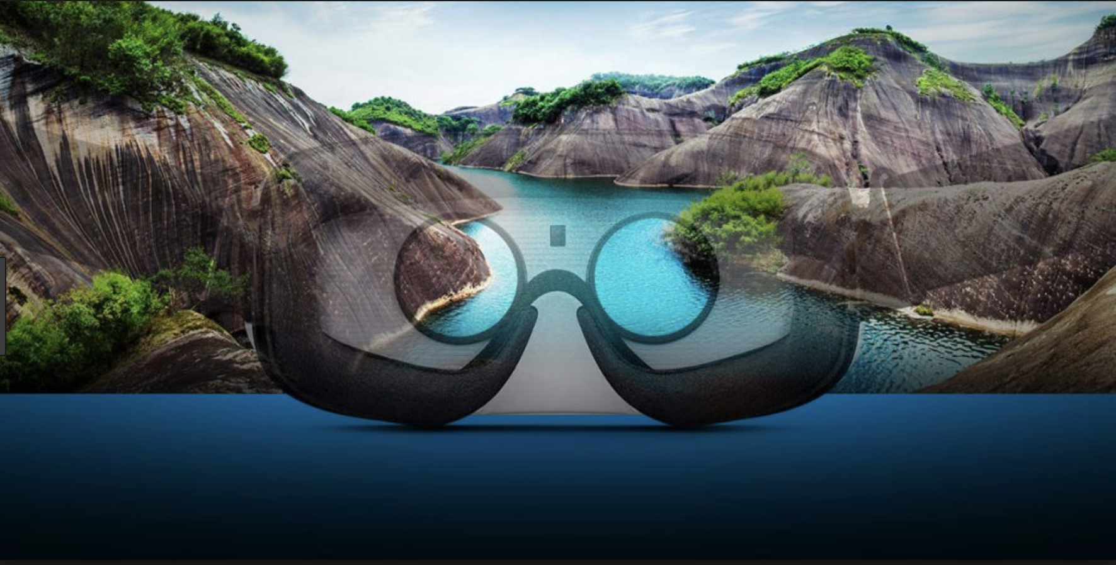
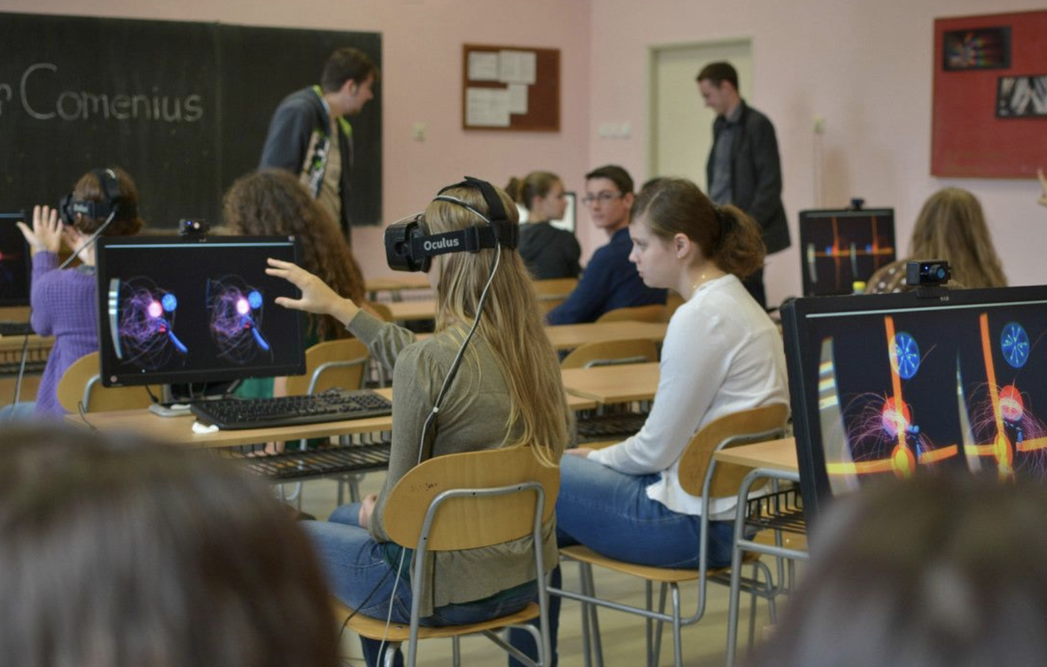
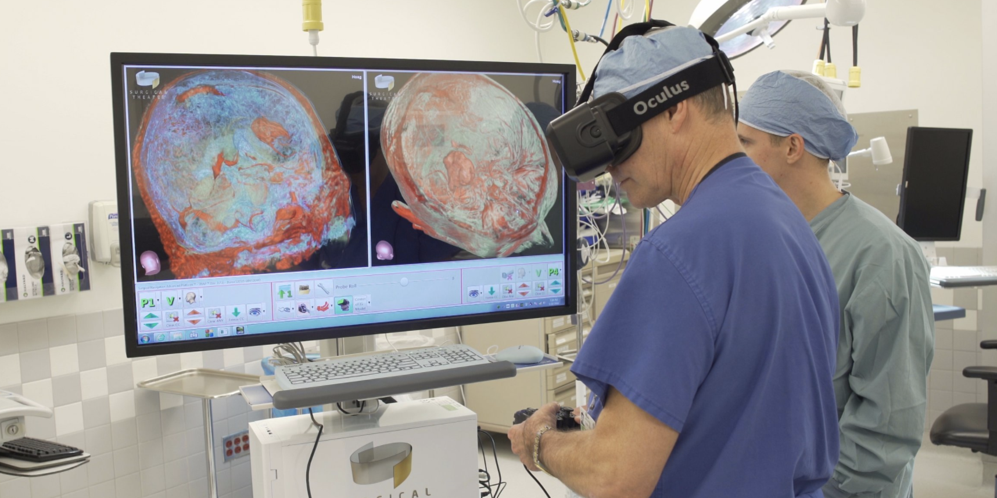

Slide 3
Concept & Motivation
Virtual reality is a hot topic
New emerging technologies supporting VR on the web
Provide an environment/platform for casual and professional users alike to experience VR

Slide 4
Requirements
Provide a platform for users to share virtual reality experiences
Provide an environment for users to learn about VR
Allow users to view & interact with other VRs
Allow users to create their own VRs
Allow users to search for VRs
Allow users to comment on other VRs

Slide 5
Web UI Requirement Principles
Focus group: peers
Personas: Engineer, 3D Artist, Layperson

Slide 6
Architecture & Design

Slide 7
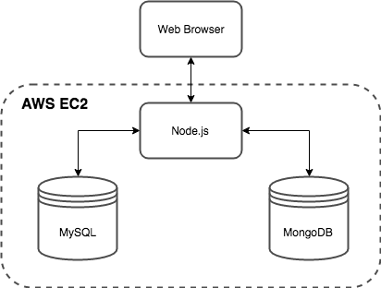
High-Level Architecture
UI: desktop/mobile web browsers
Server: Node.js, running on AWS EC2
Database: MySQL (users and VRs) and MongoDB (comments)

Slide 8
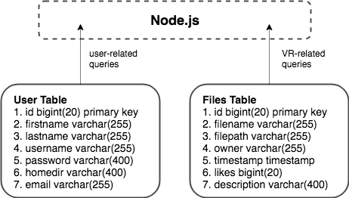
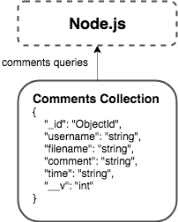
Databases used - MySQL & MongoDB

Slide 9
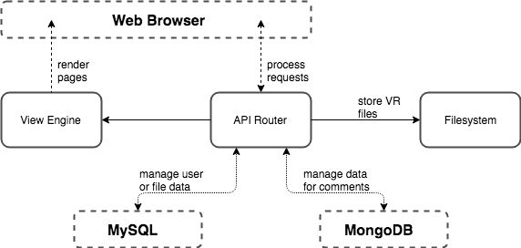
Server-side Design - Node.js

Slide 10
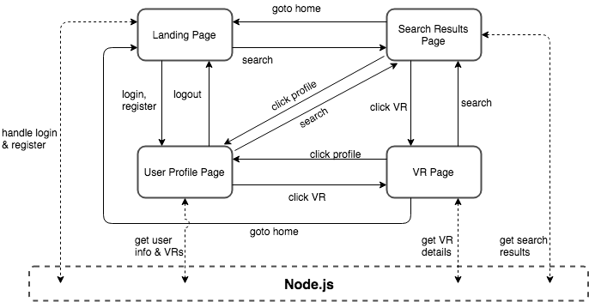
Client-side Design

Slide 11
HTML, CSS, and JavaScript
HTML5: <canvas>, <nav>
Bootstrap: navbar, flexible column layout, other misc. styling (buttons, etc.)
jQuery: used heavily to dynamically build the DOM based on the server response
A-Frame: used to display VR files

Slide 12
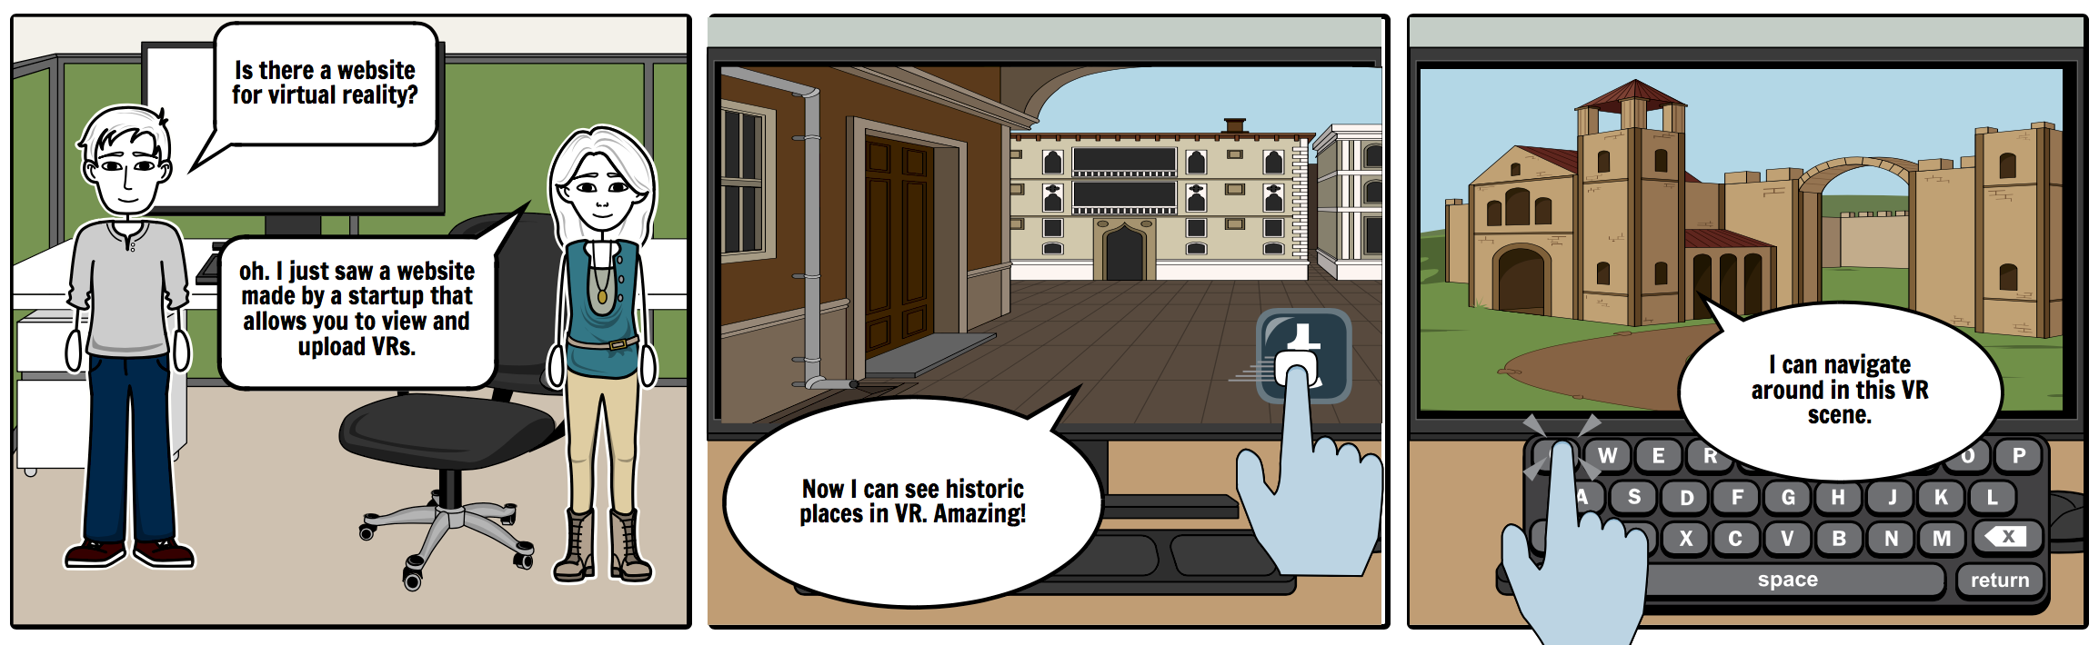
Storyboard

Slide 13
Wireframes

Slide 14
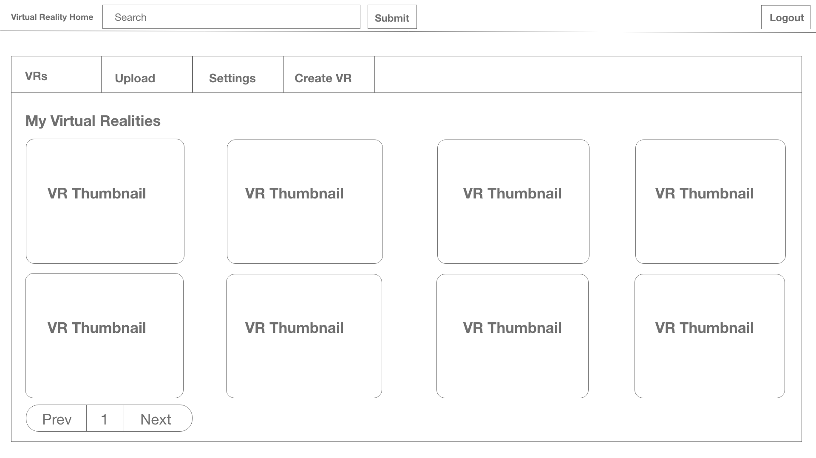
VR Home - My VRs Page

Slide 15
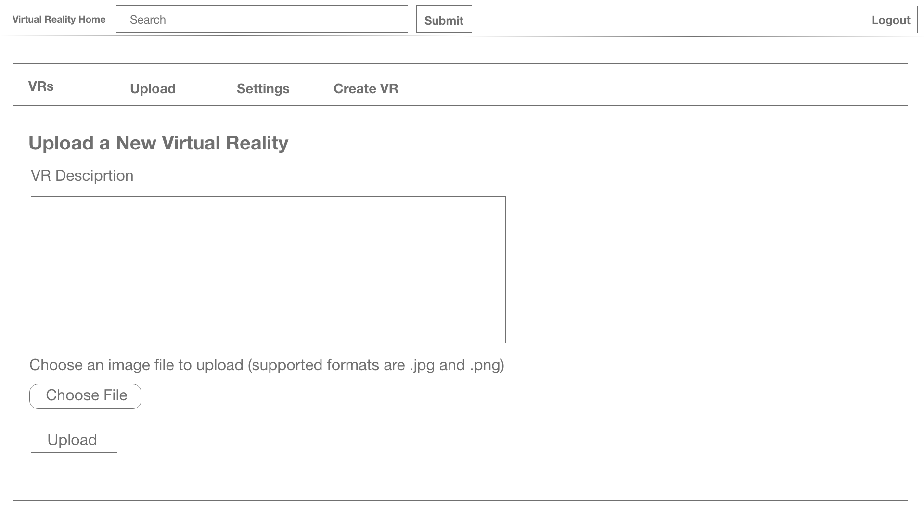
VR Home - Upload Page

Slide 16
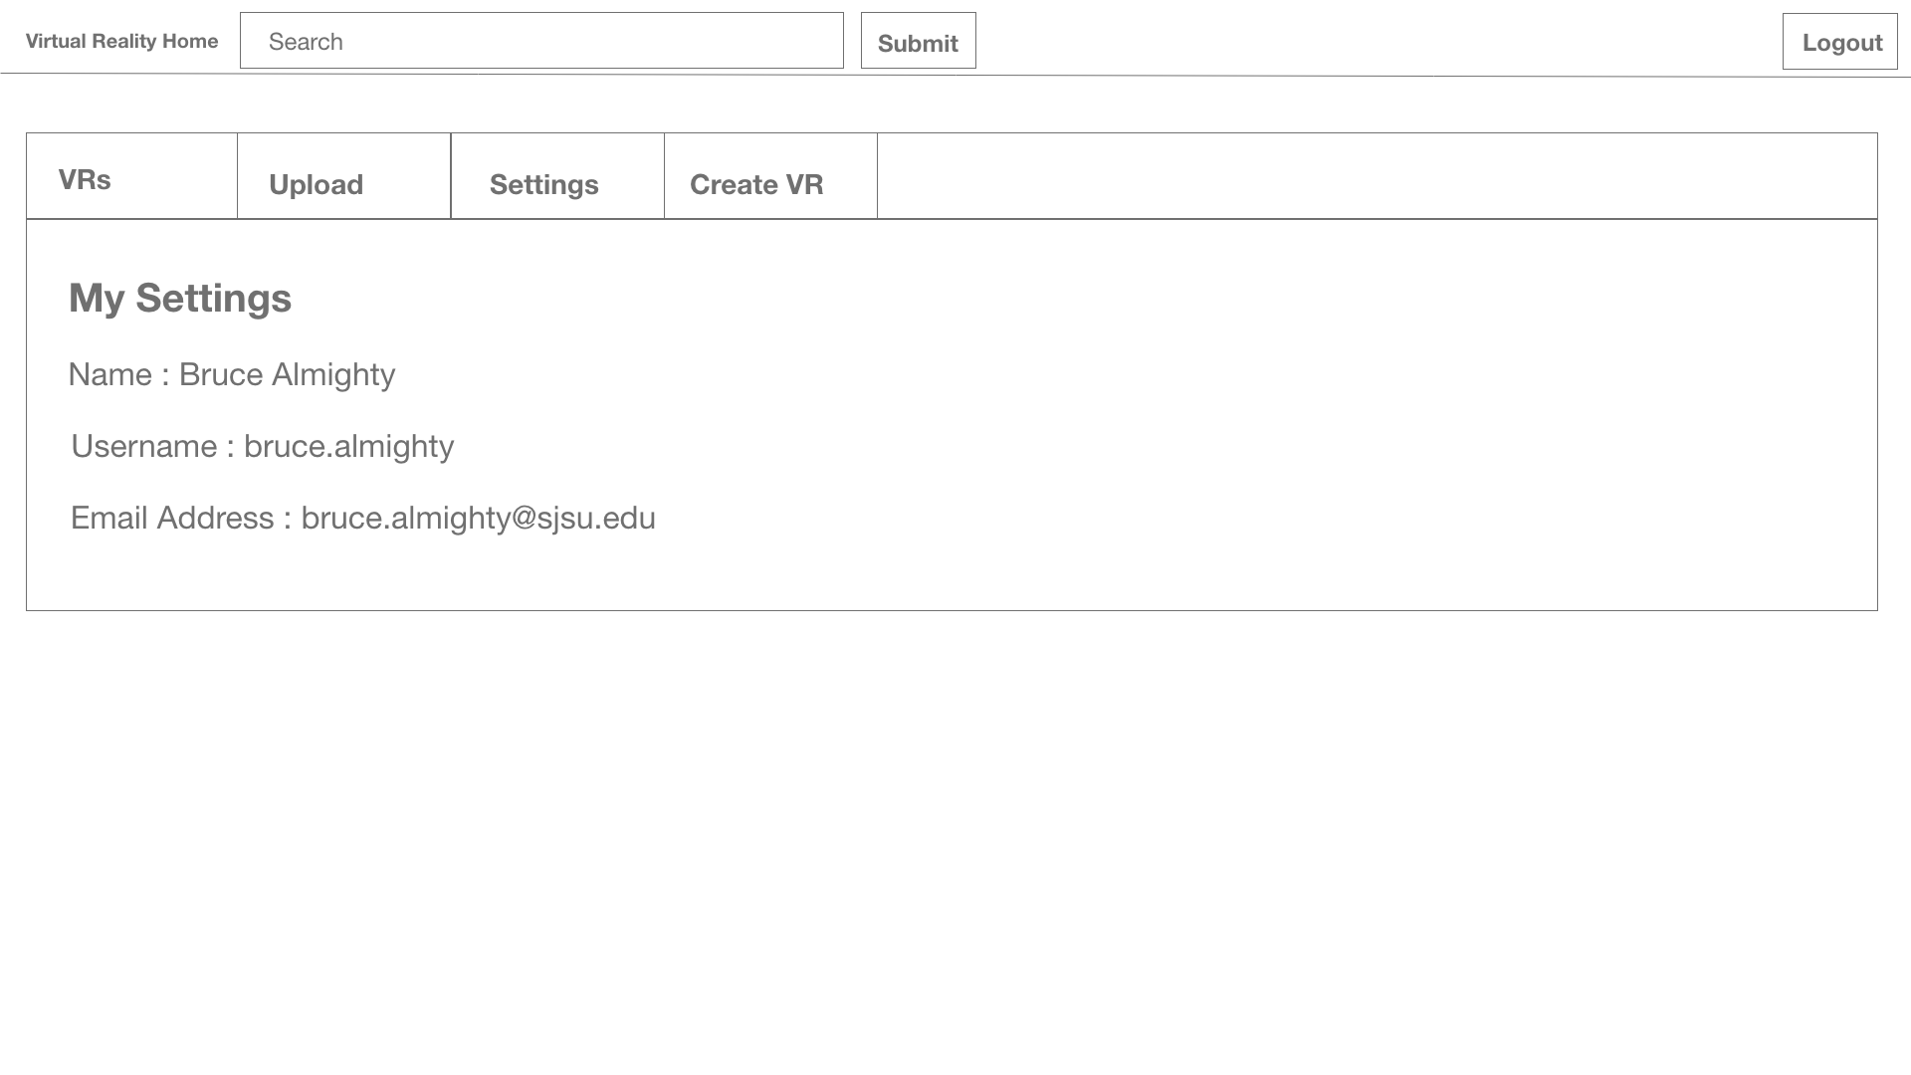
VR Home - Settings Page

Slide 17
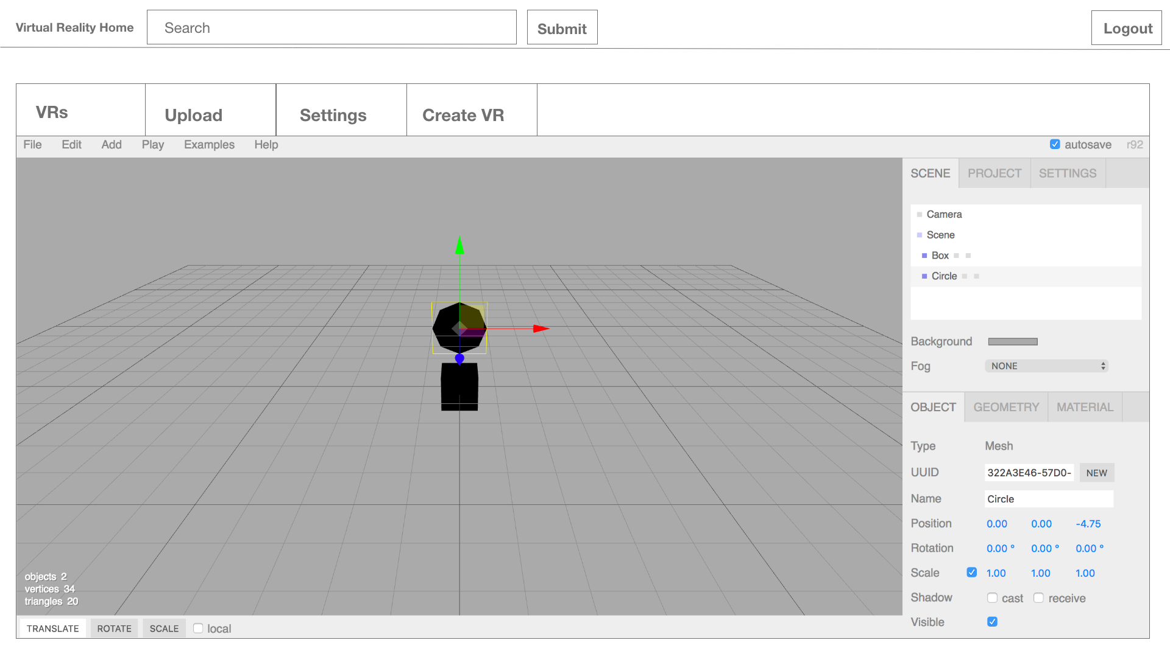
VR Home - Create VR Page

Slide 18
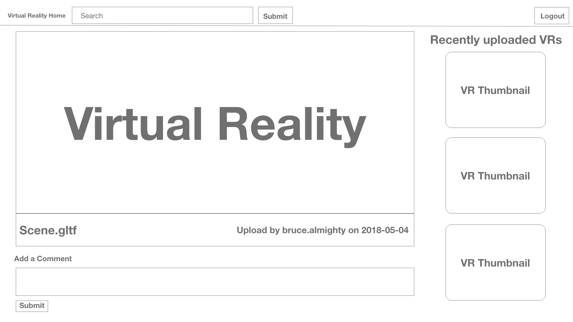
VR Home - VR Display Page

Slide 19
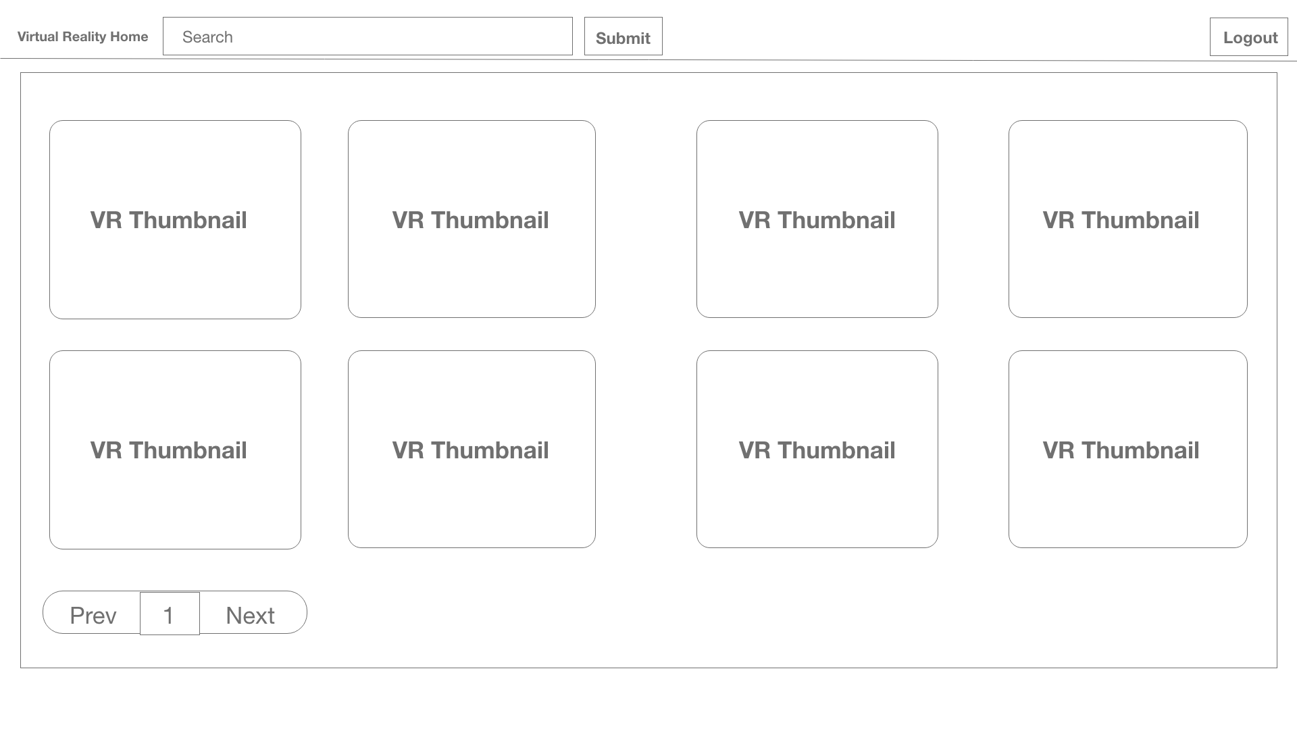
VR Home - Search Page

Slide 20
Testing
UI Testing - performed manually throughout the development phase
Server Testing - used Mocha & Chai JS Unit Testing frameworks
Interface Testing - used Postman to quickly test interfaces between server & UI
Automation Testing - used Selenium to automate end-to-end application flows
Notes:
should we show a Selenium sample test?

Slide 21
Other Features
Cross-browser, cross-platform
Search engine optimized
Chatbot
Paginated search results
Low memory footprint

Slide 22
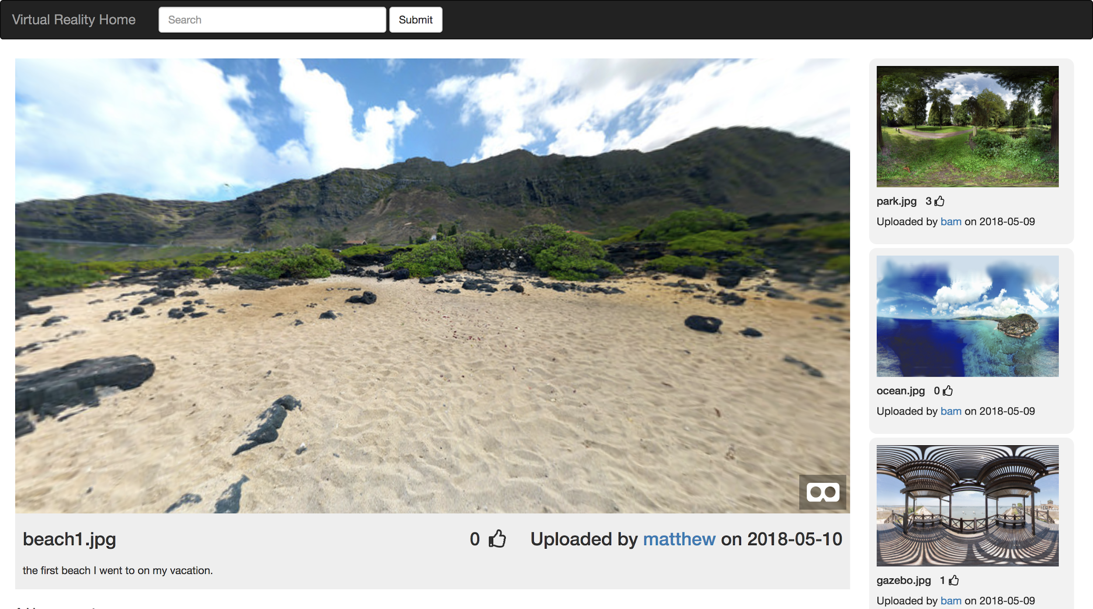

Slide 23
Demo
Questions?

